Slide 1
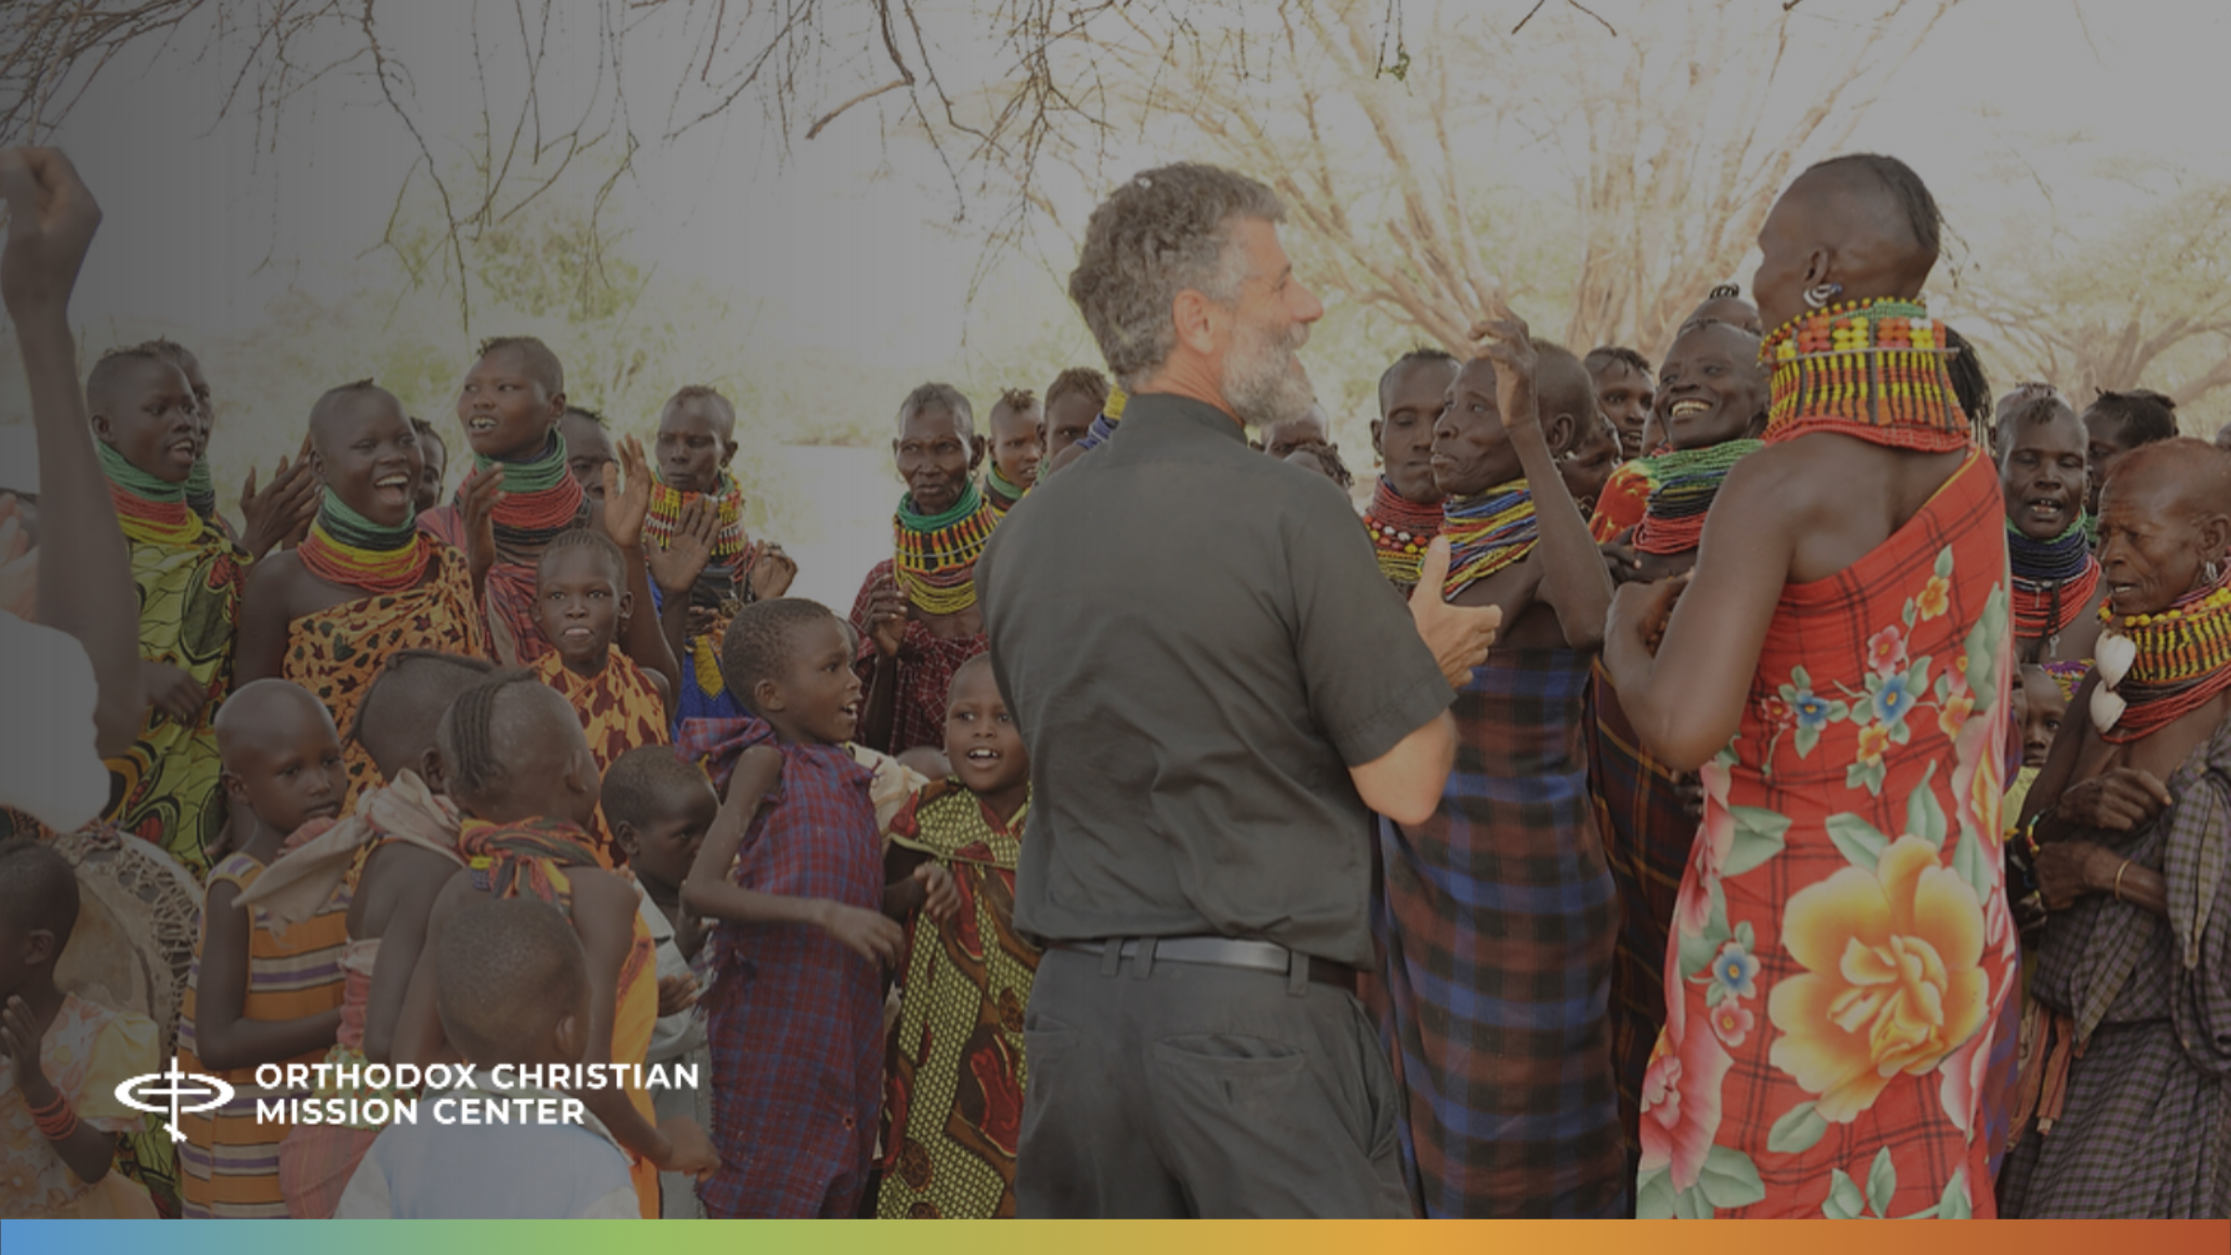
Orthodoxy in Turkana:
Mission
Sunday 2025

Slide 2
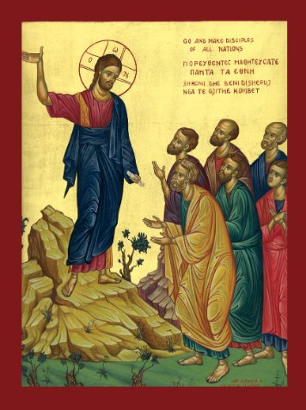
A Prayer to Begin
God of truth and love: Father, Son, and Holy Spirit, hear our prayer for those who do not know You. Make us witnesses of Your goodness, full of love, strength and faith–for Your glory and the salvation of the entire world. Amen.

Slide 3
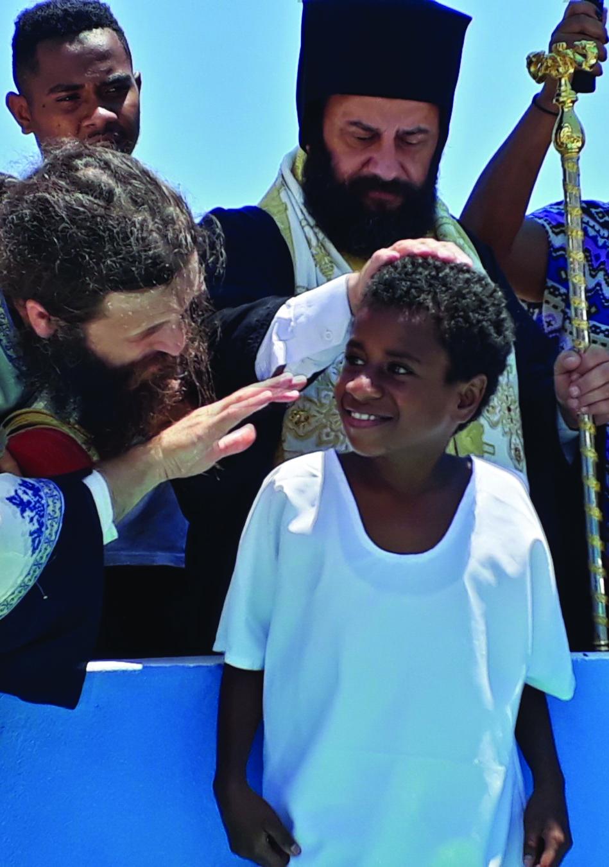
What does scripture Say about sharing our faith?
"As the Father sent me, so I also send you."
– John 20:21​
“These things I have spoken to you, that my joy may remain in you, and that your joy may be full. This is my commandment, that you love one another as I have loved you.”
– John 15:11-12

Slide 4
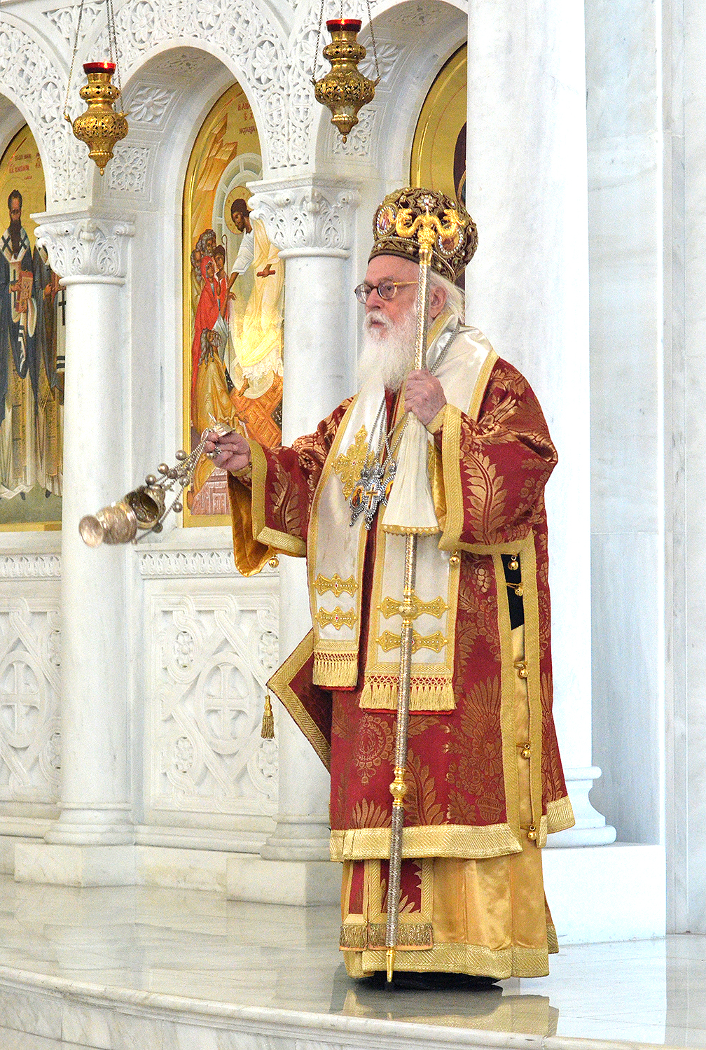
Jesus’s mission
To whom was Jesus sent?
To whom does Jesus send us?
Jesus’s mission is our mission!
Notes:
To whom was Jesus sent?
He was sent to bring the message of God’s love and mercy into our world and thereby restore us to the Father.
To whom does Jesus send us?
He sends us to the whole world, to "all the nations", “to all peoples” (Mt. 28:19), to "all creation" (Mk 16:15).
Jesus’s Mission is our mission.
Like Christ we are called to be humble, to be obedient and to love one another, and to share his message of God’s love and mercy with those who do not know Him. So that God's plan for the redemption of the all people, all creation is fulfilled.

Slide 5
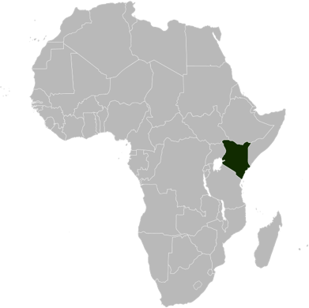
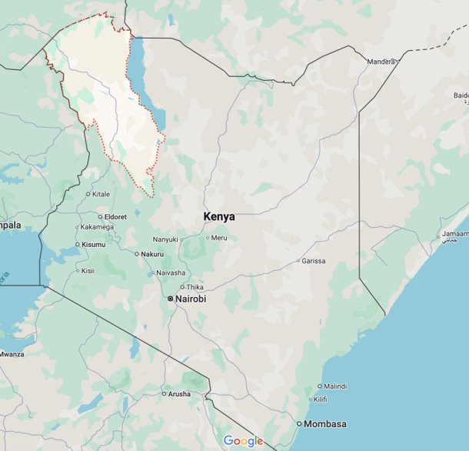
Who are the Turkana?
The Turkana people of northwestern Kenya are pastoral and nomadic, moving in search of water and grazing land for their herds. ​
Most had not heard of Jesus or the Christian message until the growing Orthodox Church of Kenya reached out to them. ​
​OCMC was invited to participate in this outreach in 2010.
Kenya
Turkana
Region

Slide 6
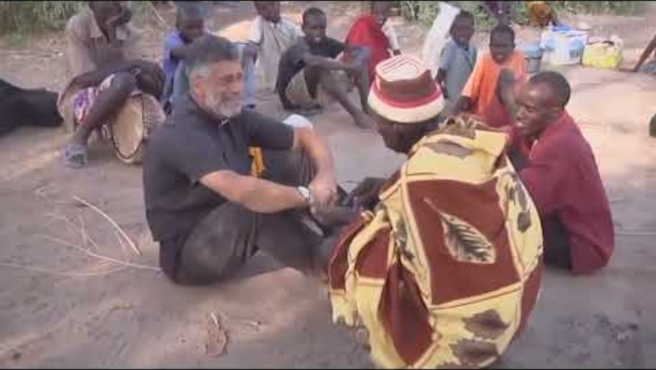
Notes:
OCMC overview video (approx. 4:40). Please note: There are other video modules available to show participants. They are posted on OCMC’s website (on the Download OCMC Materials page. Video topics include Becoming a Missionary, the SAMP Program, Grants & Proposals and Theological Training). If desired, select an additional video to show along with the Overview video.

Slide 7
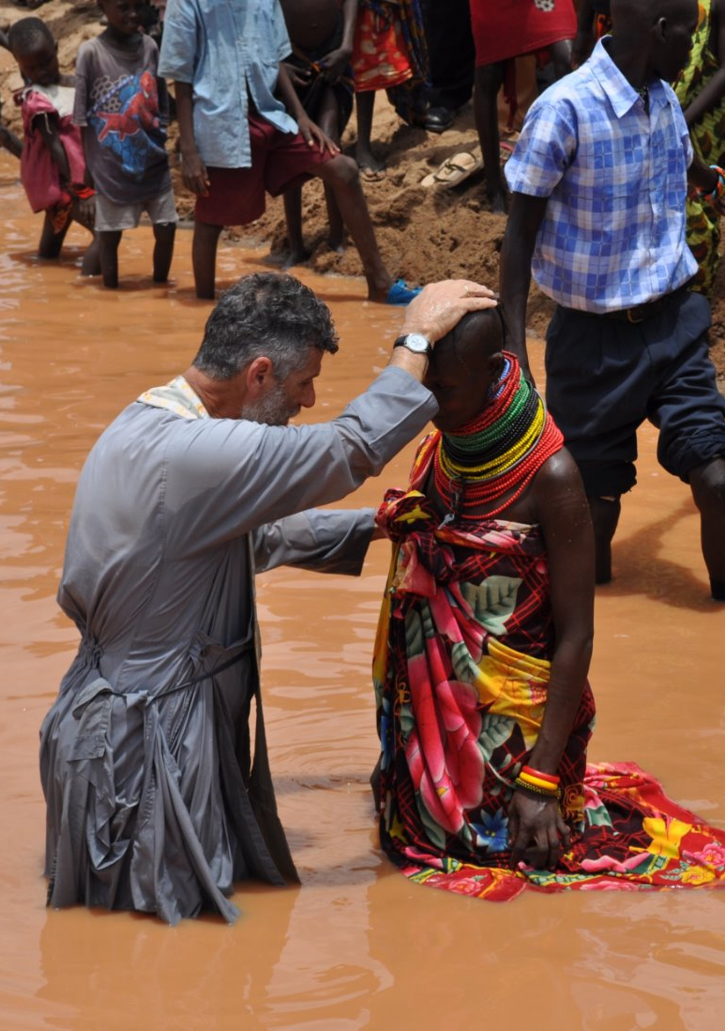
Discuss the Video
How did God use the shaman to bring the Gospel message to the Turkana people?​
What kind of sign was the water understood to be?
Notes:
How did God use the shaman to bring the Gospel message to the Turkana people?​
The shaman received a message that the visitors had crossed the river (he didn’t think they would do that) and he went to meet them. What kind of sign was the water understood to be? Was the water a sign that their message was good, or was it that the people crossed the river? Both?

Slide 8
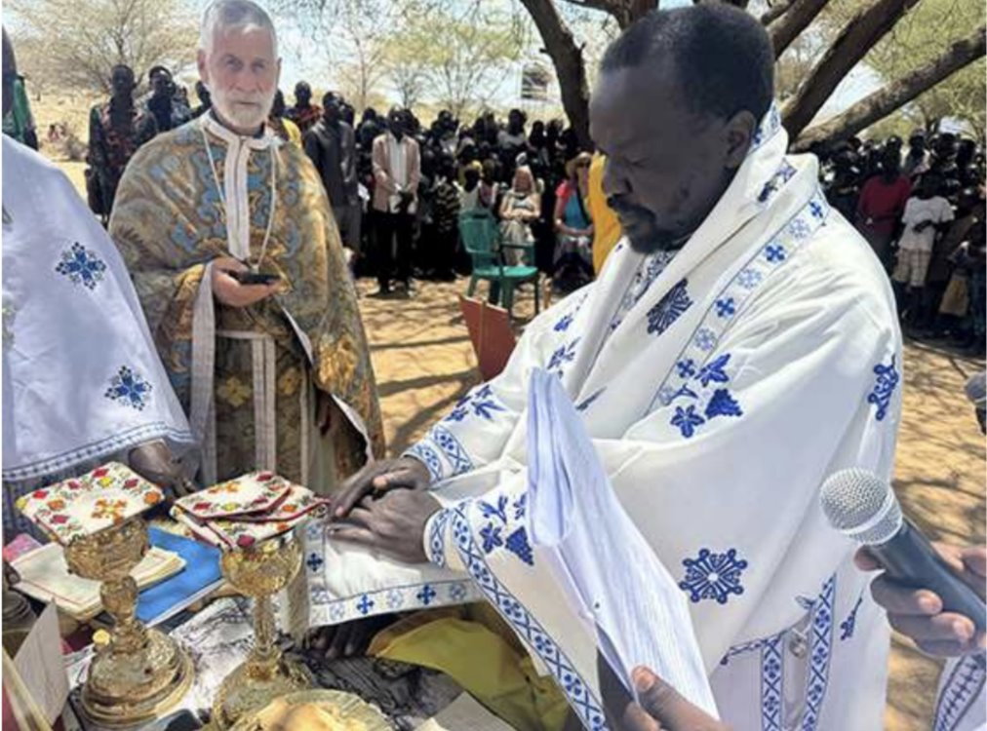
Orthodoxy in Turkana
Liturgy in Turkana, with His Grace Neofitos of Eldoret and Northern Kenya, and an OCMC team.
Notes:
Liturgy in Turkana, with His Grace Neofitos of Eldoret and Northern Kenya and an OCMC team. ​
Fr. Vladimir, who oversees four new Orthodox communities in Turkana, co-celebrated along with four other priests from Turkana.​

Slide 9
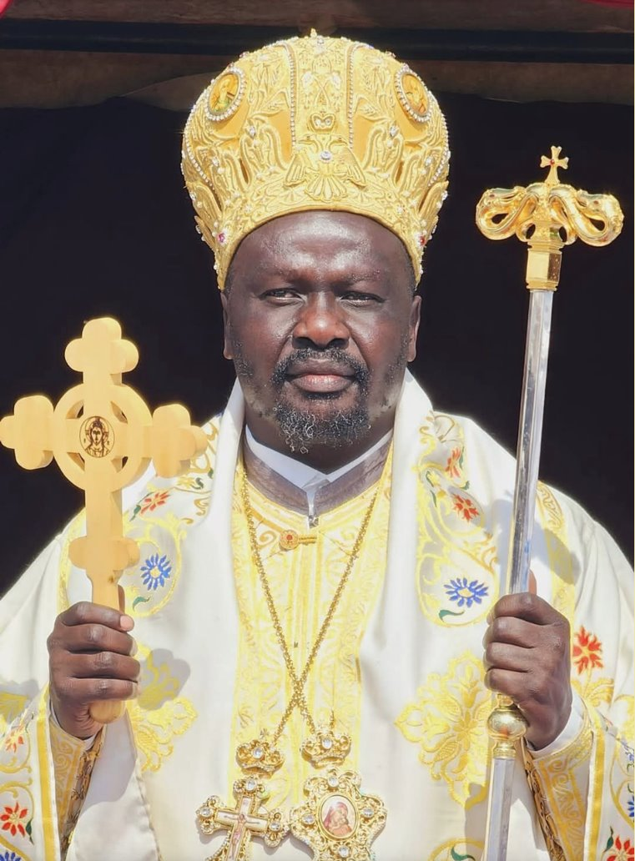
Orthodoxy in Turkana
​His Grace Bishop Neofitos ordained a new deacon as part of the celebration.
He likened this day in Turkana to the Day of Pentecost “where the Holy Spirit filled all things.”
Notes:
His Grace Bishop Neofitos ordained a new deacon as part of the celebration and about the first ordination in the Turkana district, he said: ​
“I chose to give the name of Gabriel for the new deacon because, like the Archangel Gabriel, he is always to bring the Good News of salvation of Jesus Christ to the people.”​
He likened this day in Turkana to the Day of Pentecost “where the Holy Spirit filled all things.”

Slide 10
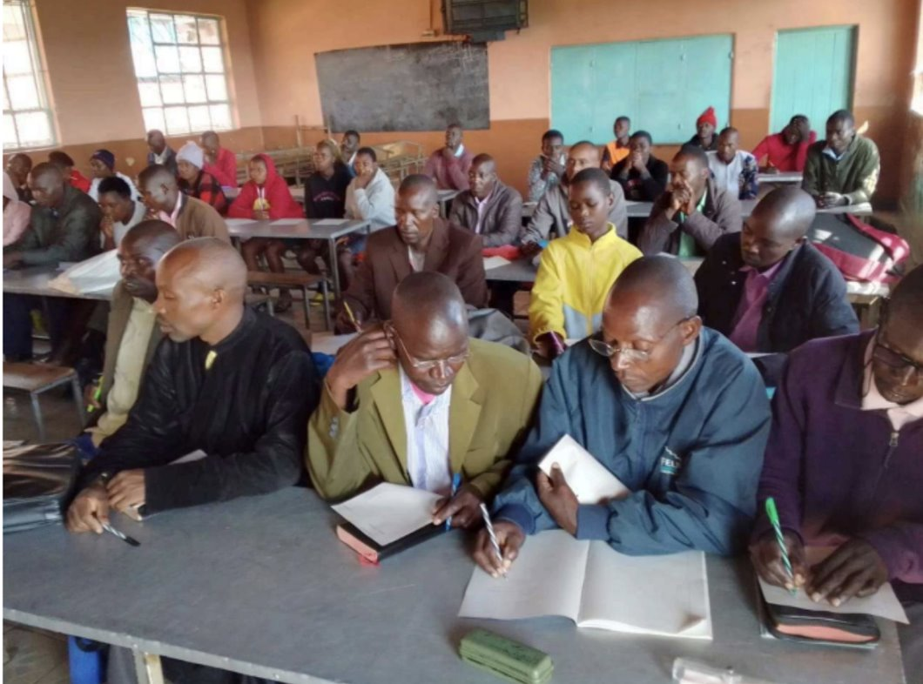
Orthodoxy in Turkana
Orthodoxy is now being introduced to 10 villages that have never heard the Gospel but want to know more. ​

Slide 11
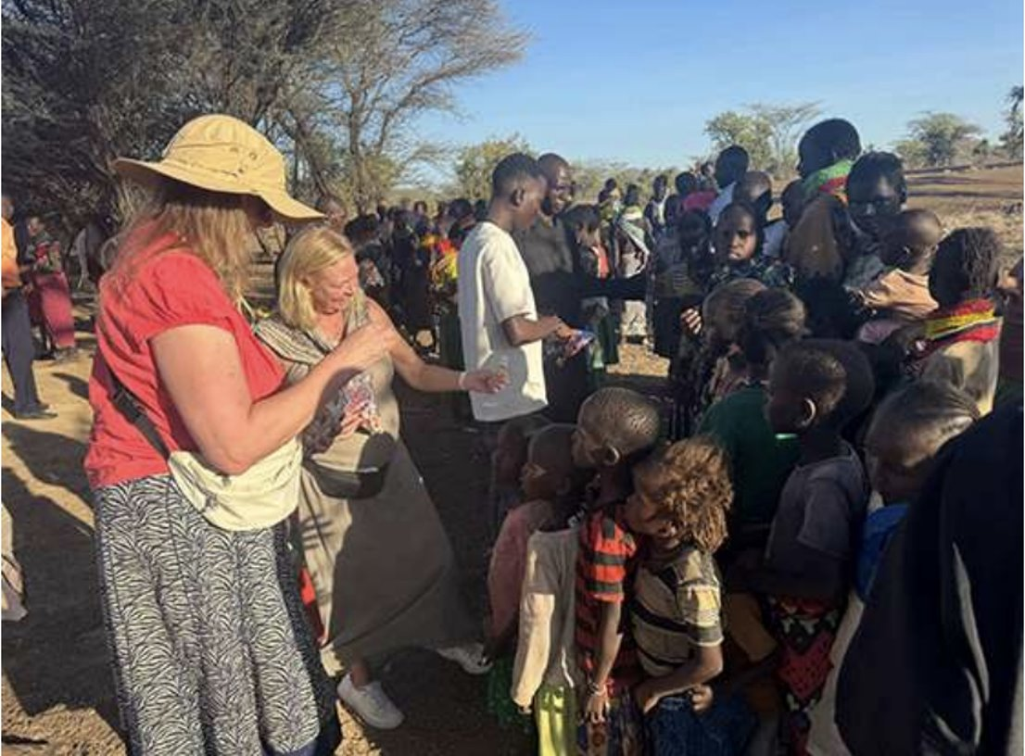
Orthodoxy in Turkana
Mission Center Activities:
assist seminaries
establish schools
dig wells
establish churches
Notes:
Orthodox Christian Mission Center mission teams have provided funds and practical help to assist seminaries, establish schools, dig wells, and establish churches.​
There is a need for theologically trained missionaries to aid in the training of catechists.​

Slide 12
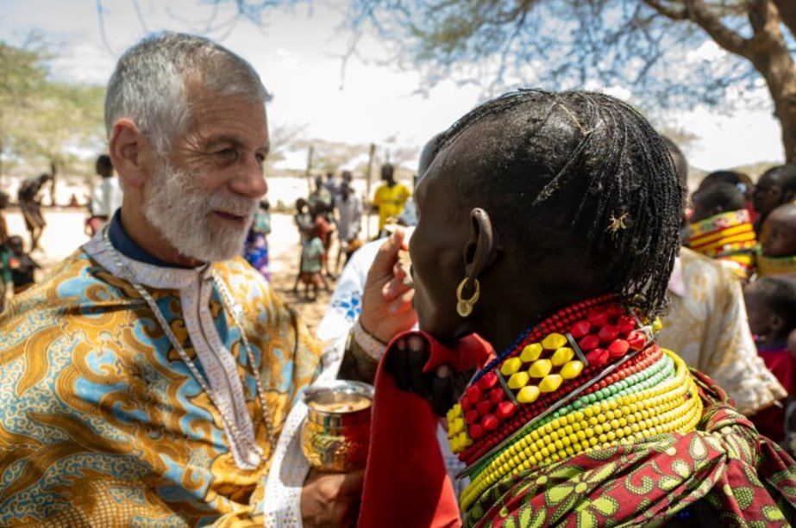
Discuss
What is our duty as Orthodox Christians to the rest of the world?
Who is my neighbor?
Luke 10:29

Slide 13
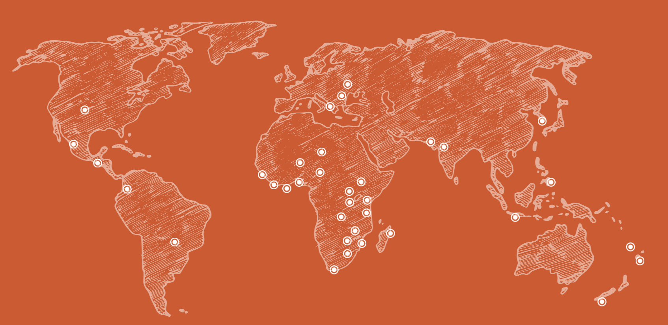
Where We Serve
The Gospel has
not been heard
The Church
has not been fully established
The population
is largely
non-Christian
We are currently active in
33 countries and 36 dioceses
Notes:
The Orthodox Christian Mission Center works to establish lasting relationships with Hierarchs and leaders in jurisdictions around the world. By opening and maintaining these pathways, we can identify and support missions in areas where:

Slide 14
Call to Action
What can you do to share your faith?
Pray for missionaries and catechists.​
Collect funds through OCMC coin boxes.
Join missions efforts at your parish.​
Bring a friend to church.​
Welcome visitors.
What other ways can you think of?
Notes:
What can you do to share your faith?
Pray for missionaries and catechists who share the Good News with others around the world. ​
Support the work of Missions with the OCMC coin boxes.​
Join the effort to support the work of missions in your parish​.
Bring a friend to church (share your faith with your neighbor).​
Welcome visitors. Many new people are coming to our Church.​
What other ways can you think of to share your faith?

