Slide 1
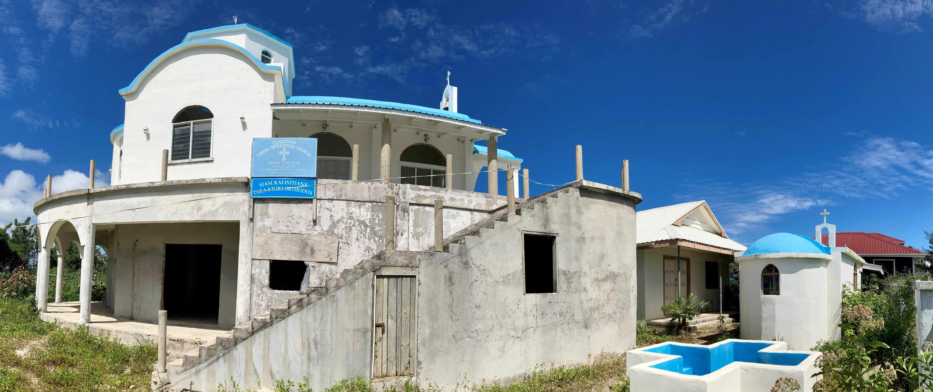
OCMC MISSION
SUNDAY LESSON

Slide 2
The Great Commission
18 And Jesus came and spoke to them, saying, “All authority has been given to Me in heaven and on earth.19 Go therefore and make disciples of all the nations, baptizing them in the name of the Father and of the Son and of the Holy Spirit, 20 teaching them to observe all things that I have commanded you; and lo, I am with you always, even to the end of the age.” Amen. (Mt 28:18-20)
Notes:
Sometimes referred to as the Last Command, these were Jesus’ last words to His disciples before he ascended into heaven, "go and tell other people the good news of God’s love." Jesus wanted everyone, all people, in the world to know God and love one another. Everyone is called to share this good news with others. We are all called to tell other people about God.
The Great Commission is also the mission of the Orthodox Christian Mission Center (OCMC), the missions and evangelism agency of the Assembly of Canonical Orthodox Bishops of the United States. OCMC’s mission is to “make disciples of all nations” by bringing people to Christ and His Church.

Slide 3
MEMORY VERSE WITH MOVEMENTS
“All authority (left hand stretched right hand a fist on top of left hand)
has been given (both hands stretched forward palm facing up)
to Me (both thumbs pointing at your chest)
in heaven (pointing finger up)
and on earth (move hands for form a circle).
Go therefore (marching)
and make disciples (arms move as bringing something under your arms)
of all the nations, (hands stretched forward and opening)
baptizing them (both hands forward as if you hold a baby and move up and down)
in the name of the Father (pointing finger up)
and of the Son (middle finger up)
and of the Holy Spirit.” (ring finger up)
(Mt 28:18-19) (bring forward 2 fingers, then 8, then 10 and then 8 and then 10 and then 9)
Matt. 28:18-19
Notes:
YouTube video available at:

Slide 4
14 How then shall they call on Him in whom they have not believed? And how shall they believe in Him in whom they have not heard? And how shall they hear without a preacher? And how shall they preach unless they are sent? 15 As it is written: “How beautiful are the feet of those who preach the gospel of peace. Who bring glad tidings of good things!” (Romans 10:14-15)
ROMANS 10:14-15
Notes:
“Unless they are sent.”
Who sends missionaries? Jesus, of course, but also His Church. Missionaries need support to go and cannot do so alone. They have the Church to send, train, equip, support, and pray for them. Missionaries are the beautiful feet that bring the gospel of peace to those who "have not believed" and "have not heard".
Who is the Church? We all are–the ones who are called to share the gospel of peace, which is Jesus Christ.

Slide 5
“How then (shoulders up and hands opened) shall they (pointing finger forward moving left to right) call (right hand by the side of the mouth) on Him (pointing finger up) in whom they have not (pointing finger up moving left to right) believed? (both hands brought together as if praying) And how (shoulders up and hands opened) shall they believe (both hands brought together as if praying) in Him (pointing finger up)
MEMORY VERSE WITH MOVEMENTS
in whom they have not (pointing finger up moving left to right) heard? (right hand by the right ear as if eavesdropping)
And how shall they (shoulders up and hands opened) hear (right hand by the right ear as if eavesdropping) without (pointing finger up moving left to right) a preacher? (right hand moves from mouth forward)
And how shall they (shoulders up and hands opened)
preach (right hand moves from mouth forward)
unless they are sent? (move feet and arms forward as going)
Romans 10:14-15
Continues Next Slide…

Slide 6
MEMORY VERSE WITH MOVEMENTS
As it is written: (left hand as notebook right hand as pencil writing)
“How beautiful (right hand and left hand move as fireworks opening up)
are the feet (stamp with your feet)
of those who preach (right hand moves from mouth forward)
the gospel of peace. (bring hands forward and open them as a book)
Who bring (move feet and hands as walking)
glad tidings (pointing fingers at mouth with which you create a smile)
of good things!” (hands stretched forward with palms up)
Romans 10:14-15
Notes:
YouTube video available at:

Slide 7
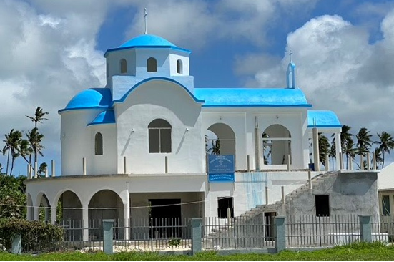
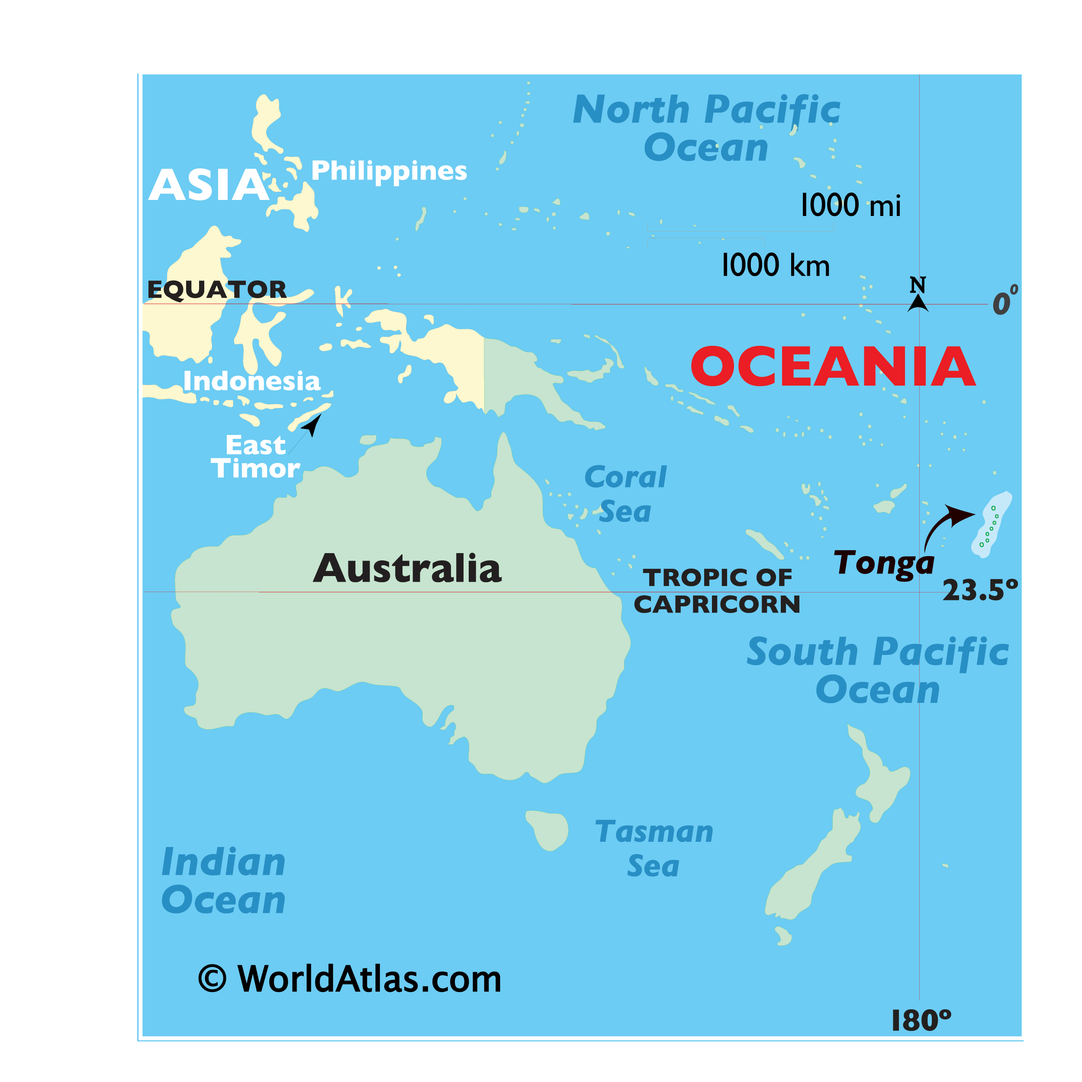
ST. GEORGE ORTHODOX CHURCH
Notes:
Slide 7
Today, we are going to learn about a beautiful white church that looks out on the blue sea of Tonga. Tonga is an island in the South Pacific (point out Tonga on the map). This is the Church of Saint George (pictured right). 15 years ago, a few Orthodox Christians came to Tonga to build an Orthodox Church. It is not finished. But already the new Church is growing and glorifying God. New churches grow because God wants us to tell others about His love and mercy.
Many people came to help build the Church. But in all that time, there has only been a priest for a year and a half. Until now, there was no one there to care for this infant parish.

Slide 8
CLEARING AWAY THE WEEDS
Notes:
Slide 8
For three years, all work at the Tonga Mission stopped because of Covid. The grounds around the church became overgrown with weeds, the walls were bare, the floors were dusty and cracked, and equipment was stolen.
Next to the church of St. George is a little chapel dedicated to Saints Peter and Paul. In this chapel, no Divine Liturgy has been sung for three years. This is because this church didn’t have a priest or a missionary to take care of it. Do you think God called someone to go and help this church? Yes! God did call someone, or at least a family to serve as missionaries and help His Tonga Mission.

Slide 9
MEET THE JONES FAMILY
Michael Jones, Father, Carpenter, and Missionary
Megan Jones, Mother, Teacher, and Missionary
Catherine Jones, age 8, Chanter
Anastasia Jones, age 7
Cecelia Jones, age 5
Elliot Jones, age 2
Notes:
Slide 9
That family is the Jones family. They heard God calling them to serve His Church in Tonga, which is far from their home in Alaska. Though they had to leave their home, they desired to share God’s love and help the Church there to grow.
When Michael Jones first heard about the Tonga Mission from a former missionary, the Lord spoke to his heart. He knew God wanted him to go and help build the church, but Michael did not know if his wife Megan felt the same. Megan wasn’t sure at first about becoming a missionary. She thought about the Bible story of the boy who offered Jesus the five loaves and two fish to feed the five thousand people. Meagan believed God wanted her to do the same by offering her gifts and trust He would multiply them.

Slide 10
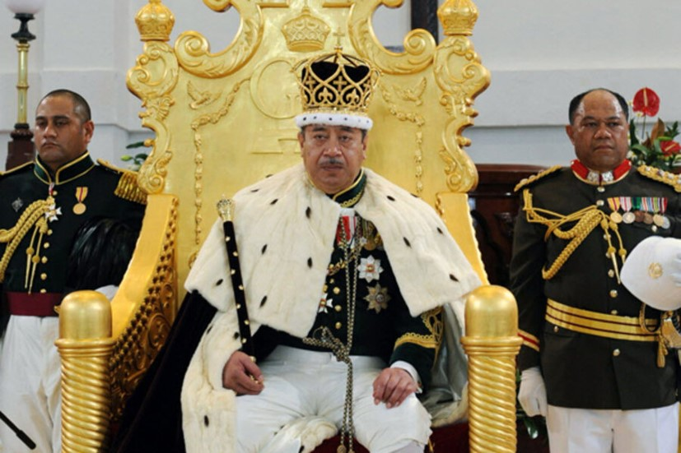
THE KING OF TONGA
Notes:
Slide 10
God has also prepared the nation of Tonga in a beautiful way. Two hundred years ago, other missionaries came to Tonga. The king became a Christian and dedicated his nation to Christ. The people of Tonga were set free. They love their Christian traditions. Their motto is “God and Tonga are our inheritance.” The Tongan people are smart and have understanding hearts. When they learn about the Orthodox Church, they like its traditions and beauty. They say the beauty of the “little white church” tells us that something good is coming to Tonga.
The Tonga flag is one of many ways Christianity has formed the country. The shortened cross of red is a symbol of the Christian faith, and the color red symbolizes the blood shed by Jesus at the Crucifixion.

Slide 11
EVERYONE IS WORKING
Notes:
Slide 11
Michael and Megan work alongside Fr. Bartholomew and his wife Presbytera Lydia, whom they had met in Fiji, helping to restore the Church in Tonga. Even their children help to serve by chopping weeds on the church grounds and chanting during the services.
The challenge to each of us is, first, to live the Orthodox life: to live so that the gospel of peace shines through us to everyone around us. Next, we pray and ask God how He wants us to help and serve His Church. What are some things you can start doing from now to bring the gospel of peace to others? You can help clean up your community like the Jones and Fr. Bartholomew’s children as seen in the picture.

Slide 12
MICHAEL & FR. BARTHOLOMEW
Fr. Bartholomew is a priest from Fiji sent by the Archdiocese of New Zealand
Michael Jones is a missionary sent by OCMC in America
Notes:
Slide 12
Fr. Bartholomew (right) and his family came to Tonga to be missionaries by Archdiocese of New Zealand, and he now serves as the priest for the Tonga mission. Michael and Fr. Bartholomew are working together to tell people about Jesus. That God loves all people
Although he is not a priest, God called Michael to use his gifts as a carpenter and Megan to use her gifts as a teacher and mother. Both are actively contributing to the growth of the Church in Tonga as OCMC Missionaries. When asked why his family became missionaries, Michael said, “We came because we could, and no one else was coming.”
Their mission work in Tonga is supported by OCMC and its many supporters in the United States who believe in the important work of Orthodox missions.

Slide 13
CELEBRATING THE LITURGY
Notes:
Slide 13
For now, they celebrate the liturgy in the small chapel of Saints Peter and Paul. Every day, work on the church continues, and soon it will be ready. Already, the Church itself has begun to tell the people of Tonga that, “God has come to live among the people.”

Slide 14
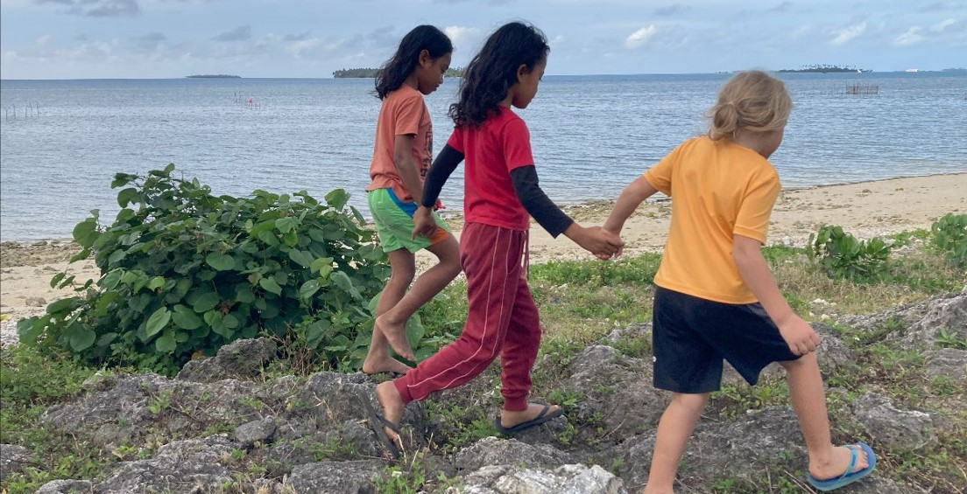
HOW BEAUTIFUL ARE THE FEET…
Notes:
Slide 14
The Jones family and Fr. Bartholomew and Pres. Lydia’s family are living an Orthodox life while building the church. They are the “beautiful feet” that bring the gospel of peace to Tonga. They understand that growing the Church will take time, as relationships require years to build. Please pray for them, and also for all those whose lives they will touch with the good news of God’s love.

Slide 15
TONGA MISSION TOUR
Notes:
Slide 15
Tonga Mission Tour – 4 minutes video introducing the people in Tonga and the Jones Family.
On YouTube at: https://youtu.be/NWX4ggLoJyE.

Slide 16
Notes:
Slide 15
Activity 1 – Complete the fill in the blank with the correct word picture.

Slide 17
Answers
Notes:
Slide 16
Answer Key to Activity 1

Slide 18
JOIN THE MOVEMENT
Pray for Orthodox missionaries, mission team members, and priests daily.
Give in support of OCMC so that more can be done to share the Faith.
Go serve at home as an Ambassador or abroad as a Missionary or Team member.
1-877-463-6784 www.ocmc.org
Orthodox Christian Mission Center
© 2024 All rights reserved.
Notes:
Slide 18
Pray - pray for Orthodox missions in Tonga and all around the world? As you pray be opened to see if God might be calling you to serve someday alongside the Jones family or other missionaries. Ask God how He can use your gifts and call others to be missionaries. Remember what Michael said, “We came because we could, and no one else was coming.”
Give - help OCMC by collecting money in your coin boxes so that more can be done to share God’s love.
Go - pray for more people to go and serve and that one day you may become an OCMC Ambassador in your parish or go to be a missionary or join a mission team.

